Slide 1
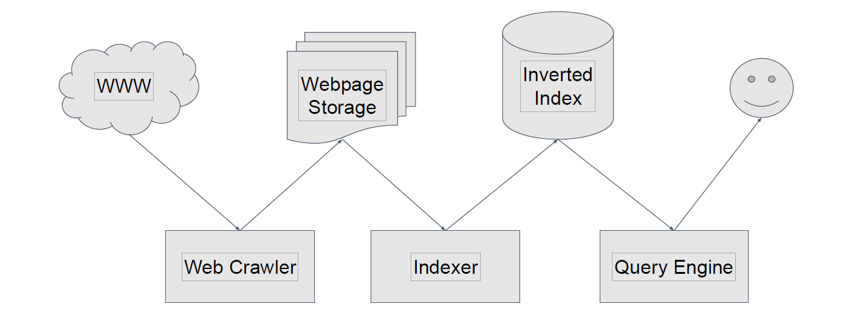
Search engine

Slide 2
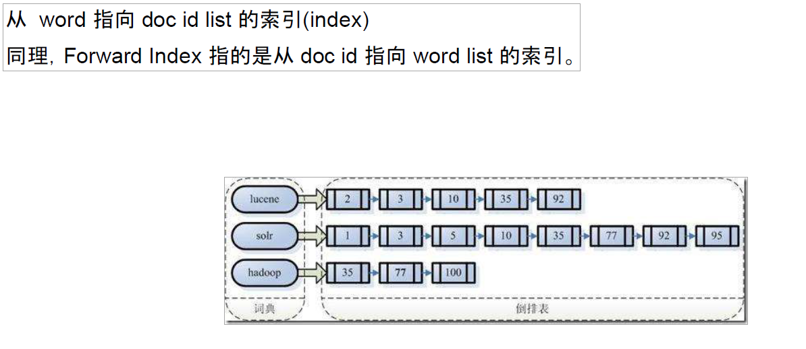
倒排索引 Inverted Index

Slide 3
中文分词 Chinese Word Segmentation
海水朝|朝朝朝|朝朝|朝落
浮云长|长长长|长长|长消
维特比算法 Viterbi Algorithm
https://en.wikipedia.org/wiki/Viterbi_algorithm

Slide 4
Page rank: https://en.wikipedia.org/wiki/PageRank

Slide 5
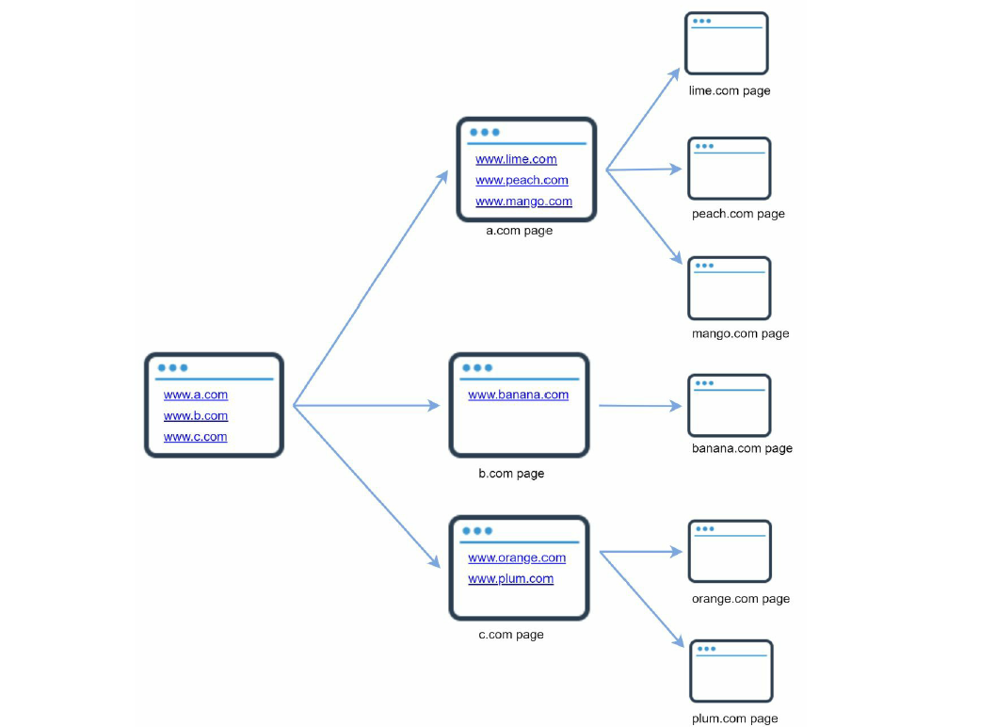
Web crawler

Slide 6
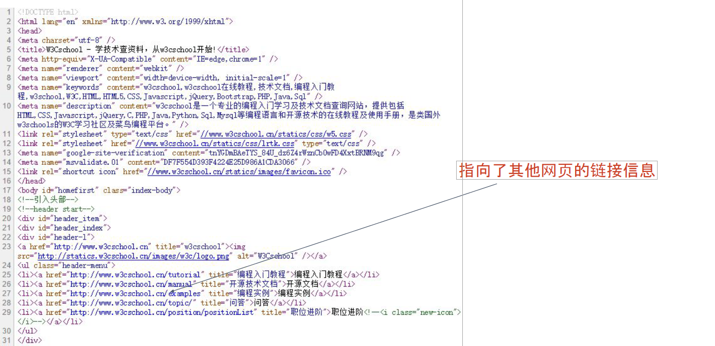

Slide 7
Used for
Search engine indexing ： google, baidu
Web archiving: US Library of Congress
Web mining: financial firms
Web monitoring: copyright and trademark infringements

Slide 8
Estimation
QPS: 1,000,000,000 / 30 days / 24 hours / 3600 seconds = ~400 pages per second.
Peak QPS = 2 * QPS = 800
Assume the average web page size is 500k.
1-billion-page x 500k = 500 TB storage per month. If you are unclear about digital storage units, go through “Power of 2” section in Chapter 2 again.
Assuming data are stored for five years, 500 TB * 12 months * 5 years = 30 PB. A 30 PB storage is needed to store five-year content.

Slide 9
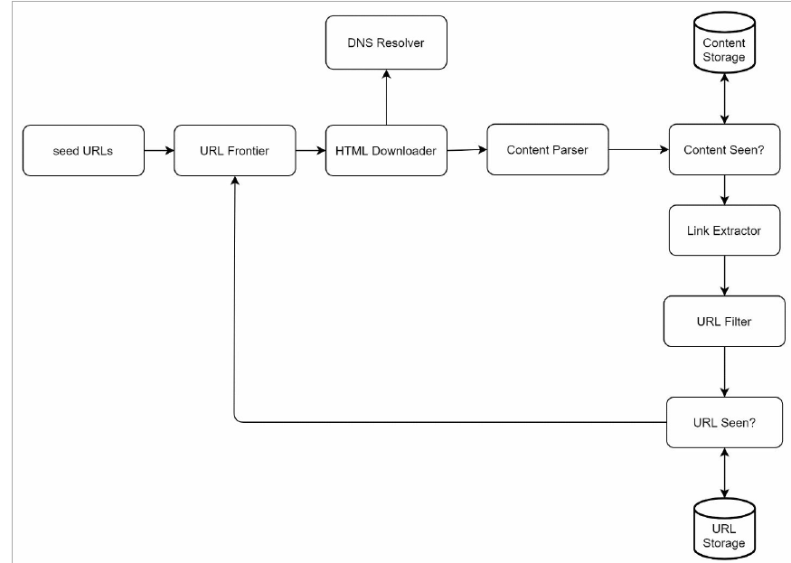
High-level design

Slide 10
Seed URLs: News, Top 100 websites.
URL Frontier: Stores URLs to be downloaded
Content Parser: filter like malformed web pages
Content Seen? Can also use like MD5
Content Storage: disk and memory
URL Extractor: extracts links from HTML pages
URL Filter: The URL filter excludes certain content types, file extensions, error links and URLs in“blacklisted” sites.
URL Seen? Bloom filter and hash table

Slide 11
Design deep dive
DFS vs BFS?
BFS is commonly used by web crawlers and is implemented by a first-in-first-out (FIFO) queue.
Can use Message Queue，like Redis, Kafka, RabbitMQ
URL frontier: can avoid sending too many requests to the same hosting server within a short period

Slide 12
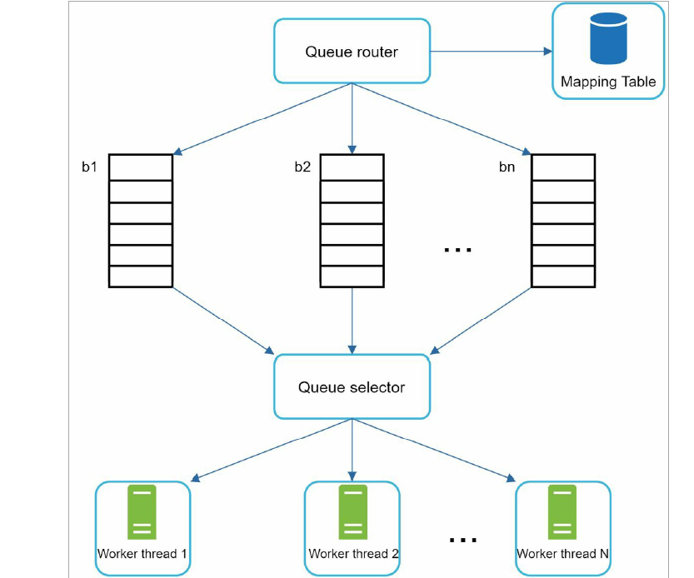

Slide 13
Queue router: It ensures that each queue (b1, b2, … bn) only contains URLs from the same host.
Mapping table: It maps each host to a queue.
FIFO queues b1, b2 to bn: Each queue contains URLs from the same host.
Queue selector: Each worker thread is mapped to a FIFO queue, and it only downloads URLs from that queue.
Worker thread 1 to N. A worker thread downloads web pages one by one from the same host. A delay can be added between two download tasks.
• Front queues: manage prioritization
• Back queues: manage politeness

Slide 15
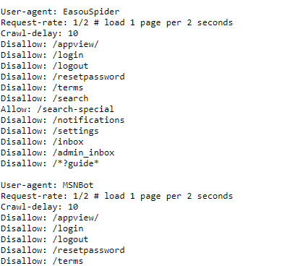
Robots Exclusion Protocol
https://www.amazon.com/robots.txt.
https://www.zhihu.com/robots.txt

Slide 16
1. Distributed crawl : multiple servers, and each server runs multiple threads

Slide 17
2. Cache DNS Resolver: Our DNS cache keeps the domain name to IP address mapping.
3. Locality: closer and faster
4. Short timeout: Slowly or may not respond at all. Set up maximal wait time.
Robustness : Consistent hashing, Save crawl states and data, Exception handling. Data validation.

Slide 18
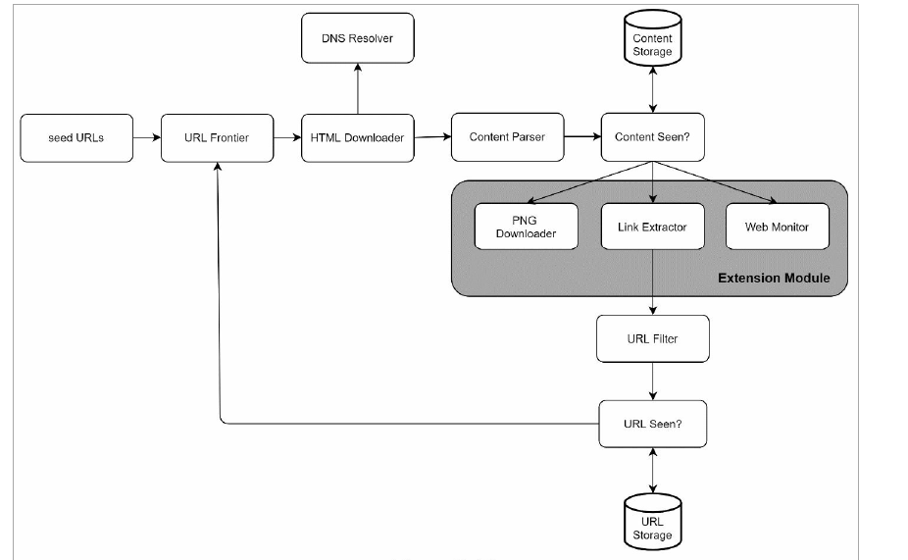

Slide 19
Detect and avoid problematic content
Redundant content: Hashes or checksums
Spider traps: causes a crawler in an infinite loop. maximal length for URLs.
Data noise: have little or no value should be excluded if possible

Slide 20
Wrap up
Server-side rendering: If we download and parse web pages directly, we will not be able to retrieve dynamically generated links
Filter out unwanted pages.
Database replication and sharding
Horizontal scaling
Availability, consistency, and reliability
Analytics

Slide 21
如何处理网页更新
URL 抓取成功以后，默认 1 小时以后重新抓取
如果 1 小时以后抓取到的网页没有变化，则设为 2 小时以后再次抓取
2小时以后还是没有变化，则设为 4 小时以后重新抓取，以此类推
如果 1 小时以后抓取到的网页发生变化了，则设为 30 分钟以后再次抓取
30分钟以后又变化了，设为 15 分钟以后重新抓取。
设置抓取时间的上下边界，如至少 30 天要抓取一次，至多 5 分钟抓取一次

Slide 22
如何处理网页失效
URL 抓取失效以后，默认 1 小时以后重新抓取
如果 1 小时以后依然抓不到，则设置为 2 小时
其他步骤类似网页更新的情况
http://www.michaelnielsen.org/ddi/how-to-crawl-a-quarter-billion-webpages-in-40-hours/

